Slide 1
Content Strategies for Today's Delivery Requirements
Rahel Anne Bailie, Intentional Design Inc.
Kevin Nichols, Kevin P. Nichols Consulting
Notes:
“Content Strategies for Today’s Delivery Requirements:
Too many teams that deliver information focus on delivery to the exclusion of their information. They pursue a technology strategy with no corresponding information strategy. Using work the speakers have done at a variety of commercial, nonprofit and educational organizations, they will talk about how you can use an information strategy and analysis to complement the information systems approach your team uses. We will discuss: how an information strategy matches business goals, user needs and information structure, how information structures bring value to both the business and the user, and how to begin creating strategy and structure in your organization. The session also looks at the nature of content and how we may need to change its development, management, and delivery to survive in a "Web 2.0" world, and what that means for forward-thinking information architects and content curators. Everyone believes that information is power, this session will help you start harnessing that power. The session will be especially useful for project teams comprised of IT and information managers.

Slide 2
Definitions
Content Strategy: A repeatable system that governs management of content throughout the entire content lifecycle

Slide 3
Definitions
Content Consumption: Primary behavioral driver for website users

Slide 4
Definitions
Content:
Contextualized, human-usable data
Contained; in other words, the stuff “between the tags”

Slide 5
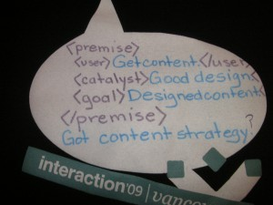
Who’s Minding the Content?
<premise>
<user>Get content.</user>
<catalyst>Good design.</catalyst>
<goal>Designed content.</goal>
</premise>
Got content strategy?

Slide 6
Assumptions
Content is a corporate asset
Content deserves to be managed well
Content has an iterative lifecycle

Slide 7
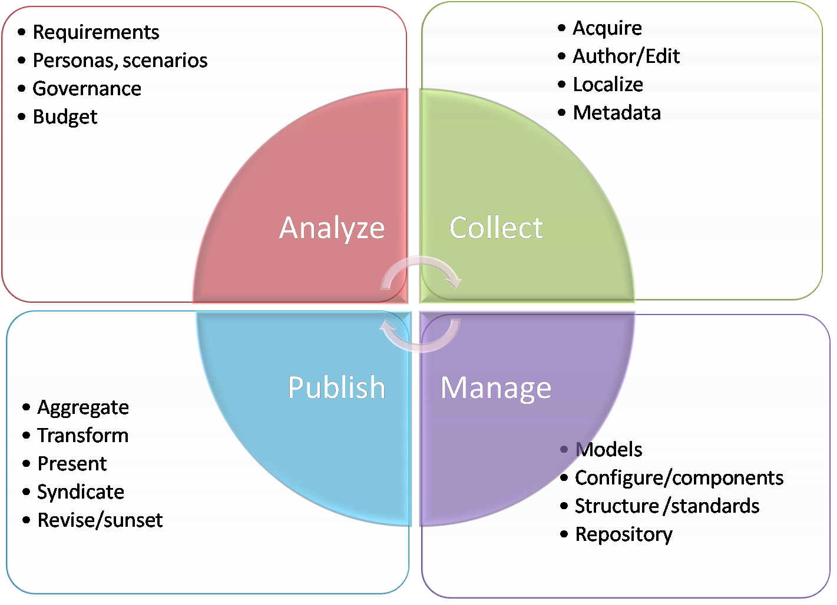
Content Lifecycle

Slide 8
Aspects of strategy
Content Approach
Business and content requirements
Taxonomy and Metadata
Searchability, findability
Editorial Strategy
Tone, voice, rules of use
Content Production Design
Workflow, business rules, single-sourcing
Web Ops Strategy
Governance, quality, change management, training

Slide 9
Value Proposition: IRR
Increase Efficiency
Clarify/standardize processes
Automate processes
Decrease system costs
Save on localization costs
Reduce turn cycle
Manage Risk
Increase accuracy
Avoid litigation

Slide 10
Value Proposition: ROI
Protect brand integrity
Better user experience
More customer trust/loyalty
Increase potential
Create value from content
Re-use content
Extend scope
Personalize content
Enter new markets

Slide 11
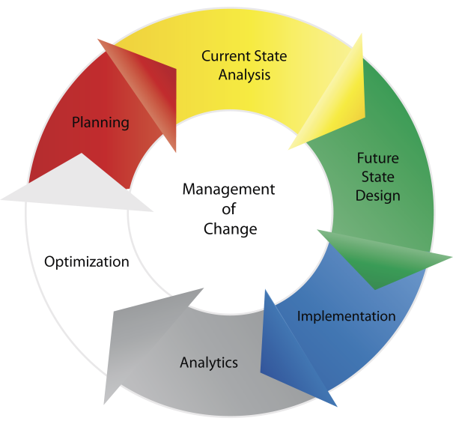
Best Practices: Process
Define Fut

Slide 12
Best Practices: Process
Understand Current-State
Business Context
Workflow
Tech/Info Landscape
Define Future-State
Resolve Current Issues
Define Governance model
Future State roadmap
Implement Projects
Pick low-hanging fruit first
Show immediate value

Slide 13
Best Practices: Process
Evaluate (Semi-annual)
Create dashboard to measure content
Benchmarks: relevance, efficacy, efficiency, consistency, etc.
Optimize and Plan
Manage change throughout
Identify success factors
Including stakeholders and users from the bottom-up through all points

Slide 14
Best Practices: Content Strategy
Right content to right user at right time
Critical to know:
Users & consumers (internal/external)
Content and its value to those who consume it
When and what users need
How to best get it to them

Slide 15
Best Practices: Caveats
Define long-term plan and short-term projects to feed it
Don’t boil the ocean
Best practices are independent of platform/technology
Accountability: ensure clear content owners
Know the standards and conform to them
Decide upon centralized or federated models for content governance and production

Slide 16
Questions?
Rahel Anne Bailie
Intentional Design Inc.
www.intentionaldesign.ca
Twitter: @rahelab
Delicious: /rahelab
LinkedIn: www.linkedin. com/in/rahelannebailie
Tel: +1.604.837.0034
Kevin P. Nichols
Kevin P Nichols’ Consulting
www.kevinpnichols.com
Twitter: @kpnichols
LinkedIn:www.linkedin.com/pub/kevin-nichols/0/b50/160
Tel: +1.617.460.1820

